Slide 1

University College Cork
Generating Images Using a Deep Convolutional GAN
Kai Deng

Slide 2

01
Introduction
02
Historical Models
Overview
03
Theoretical Background
04
Results
05
Discussion

Slide 3
University College Cork
1 Introduction

Slide 4
Introduction
01
What is GAN?
Generative Adversarial Network (GAN) was introduced by Goodfellow in 2014.
Why GAN for Image Generation?
• Generating high-quality and realistic images.
Challenges with GAN
Mode collapse, vanishing gradients, and instability.
The objective of the Thesis
• GAN with dense layers or convolutional layers.
• Exploring layer depth.
• Impact of data augmentation.
• Applying the GAN model with the Animal Faces-HQ dataset.

Slide 5
University College Cork
2 Historical
Models

Slide 6
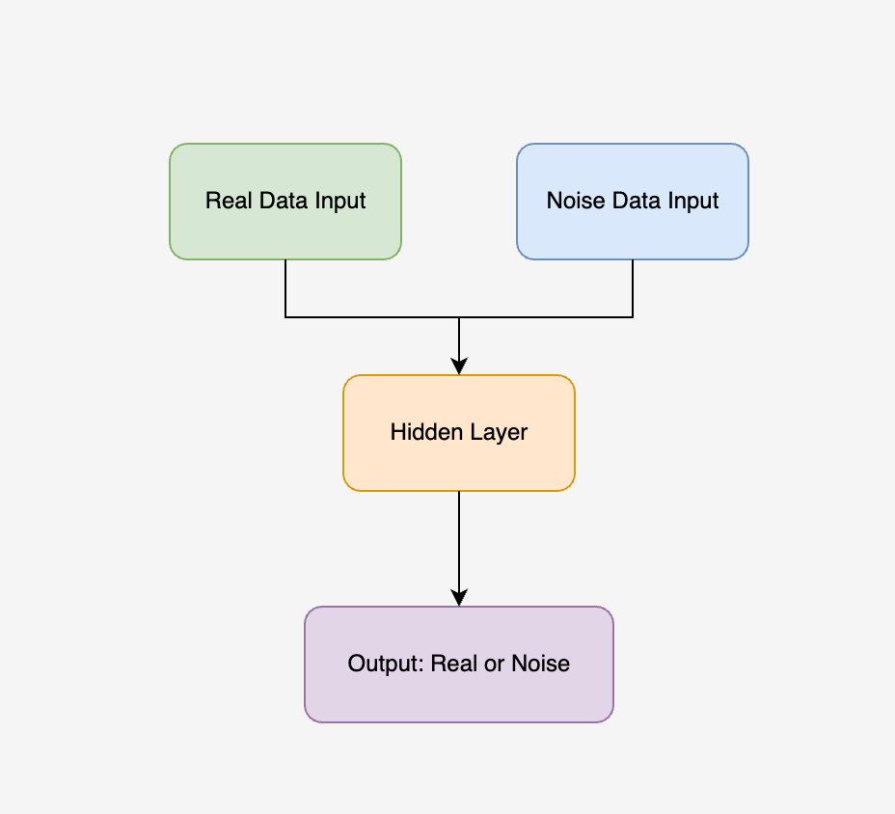
02
Noise Contrastive Estimation
What is the NCE?:
Introduced in 2010 by Gutmann is a statistical method that simplifies learning by contrasting real data with noise.
Architecture:
• Two data inputs: Real data and noise samples.
• The model classifies between real and noisy data using binary classification.
Applications:
• Density estimation and language modelling.
• Laying the groundwork for image generation.

Slide 7
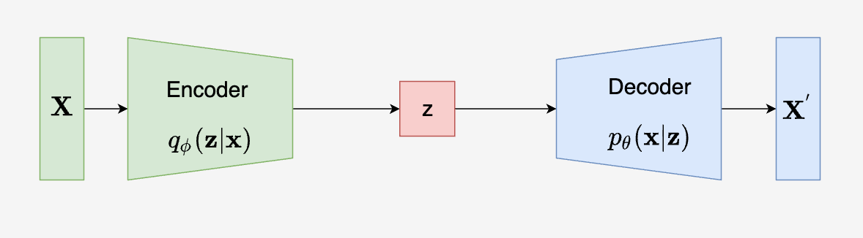
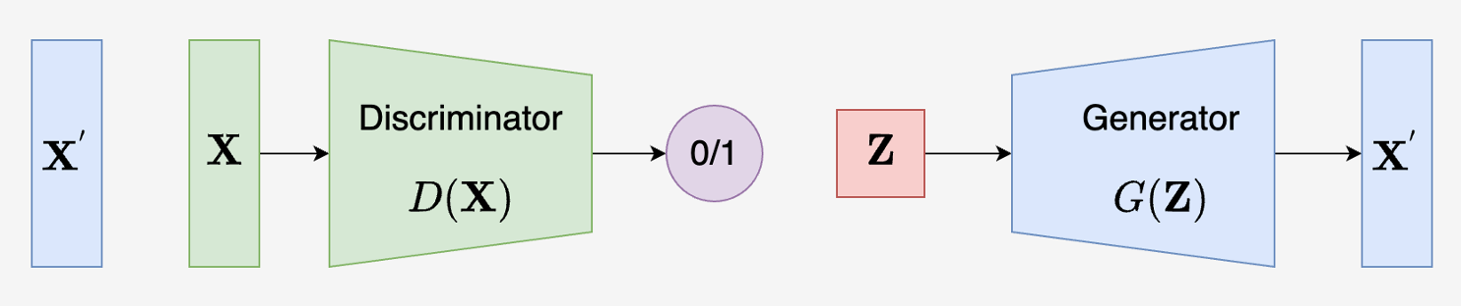
03
Variational Autoencoder
What is the VAE?:
Introduced in 2013 by Kingma, VAE is a generative model that encodes input data into a latent space and reconstructs it by minimizing the reconstruction loss.
Architecture:
• Encoder: Compresses the input data into latent space.
• Decoder: Rebuilds the data from the latent space.
Applications:
Image generation, data compression, and outlier detection.

Slide 8
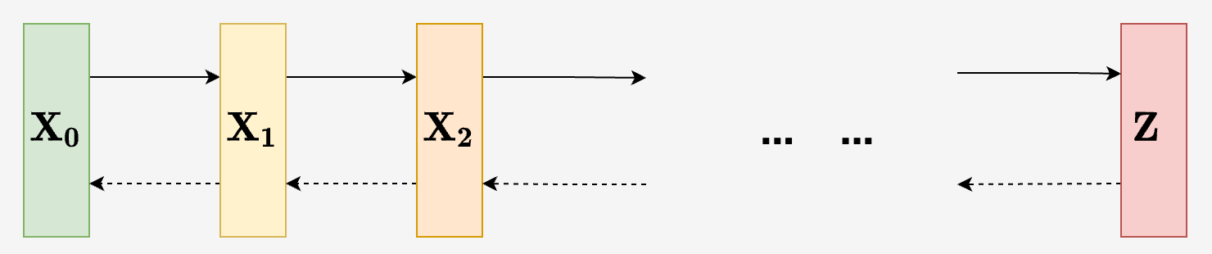
Diffusion Model
04
What is the Diffusion Model?:
Introduced in 2020 by Jonathan, these models progressively add noise to the data and learn to reverse this process to generate high-quality outputs.
Architecture:
• Forward Process: Gradually adds Gaussian noise to the data.
• Reverse Process: Reverse the noise addition to reconstruct the original data.
Applications:
Image generation and audio synthesis.

Slide 9
University College Cork
3 Theoretical Background

Slide 10
Generative Adversarial Network
05
What is GAN?:
GAN was introduced by Ian Goodfellow in 2014. It consists of two networks a generator and a discriminator that compete to improve data generation quality.
Architecture:
• Generator: Creates fake data.
• Discriminator: Distinguishes between real and generated data.
Applications:
Image generation, video synthesis, and style transfer.

Slide 11
06
Objective Function of GAN
Objective Function:
• It is a minimax game between the generator and the discriminator.
• It’s a constant push-and-pull between the two networks, which results in both improving over time.
Generator’s Goal:
Minimize the probability the discriminator correctly identifies fake data.
Discriminator’s Goal:
Maximize the probability of correctly distinguishing real from fake data.

Slide 12
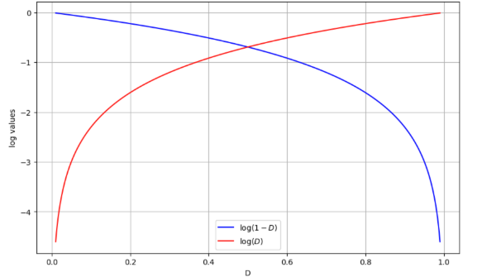
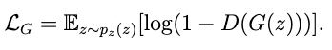
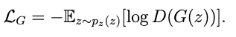
07
Loss Function of GAN
Discriminator’s Loss:
Measures how well the discriminator classifies real and fake data.
Loss function:
Generator’s Loss:
Measures how well the generator fools the discriminator.
Loss function:

Slide 13
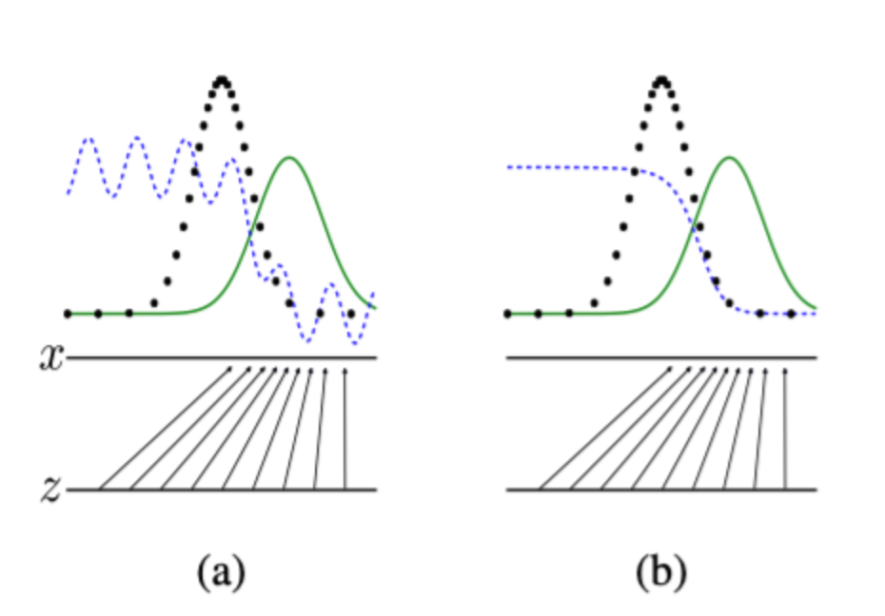
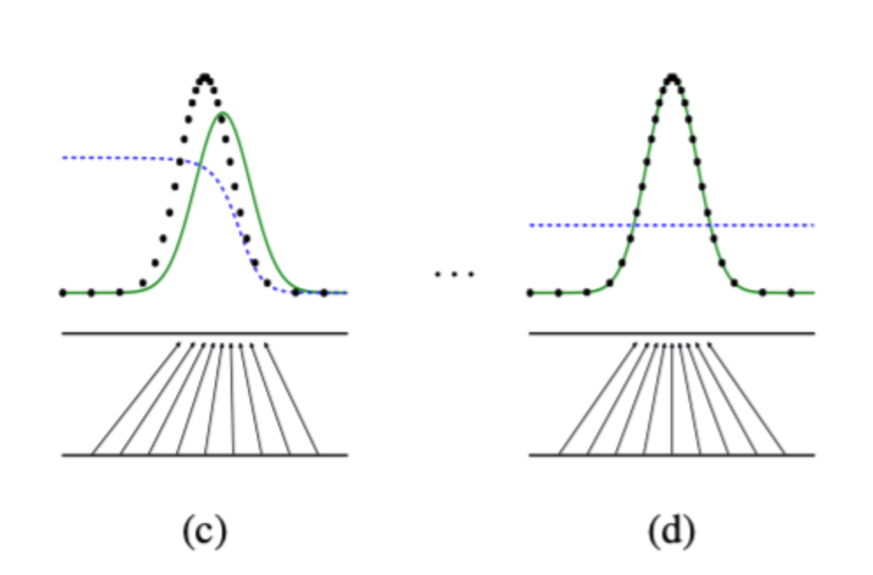
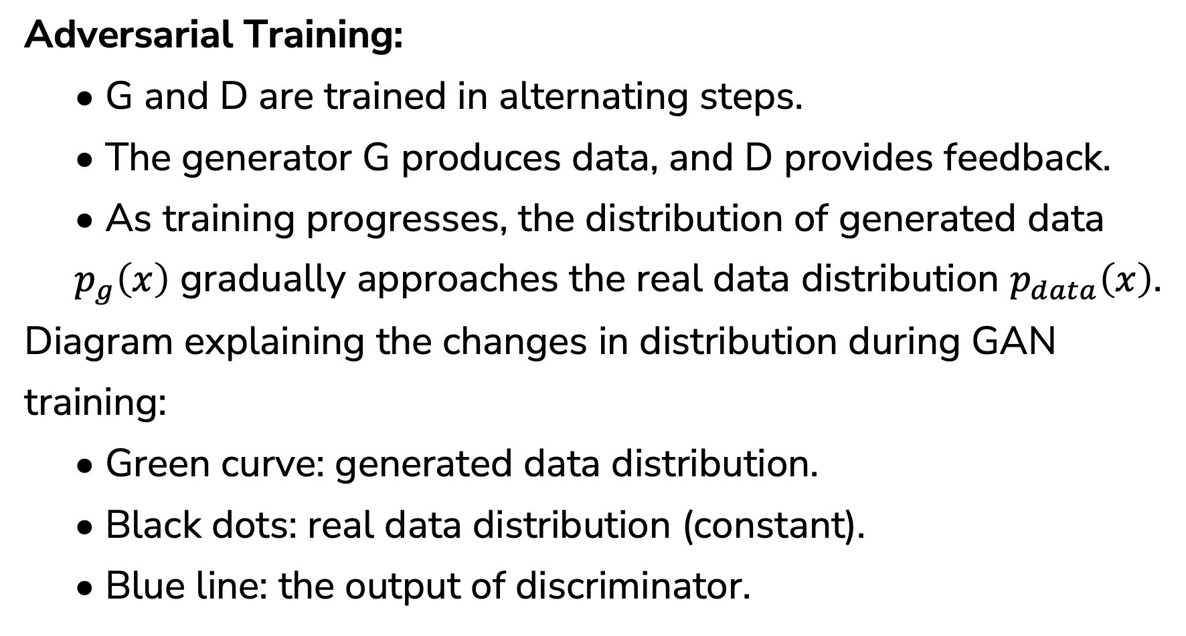
08
Training Process of GAN
Adversarial Training:
• G and D are trained in alternating steps.
• The generator G produces data, and D provides feedback.
• As training progresses, the distribution of generated data $p_{g}\left(x\right)$ gradually approaches the real data distribution $p_{data}\left(x\right)$.
Diagram explaining the changes in distribution during GAN training:
• Green curve: generated data distribution.
• Black dots: real data distribution (constant).
• Blue line: the output of discriminator.

Slide 14
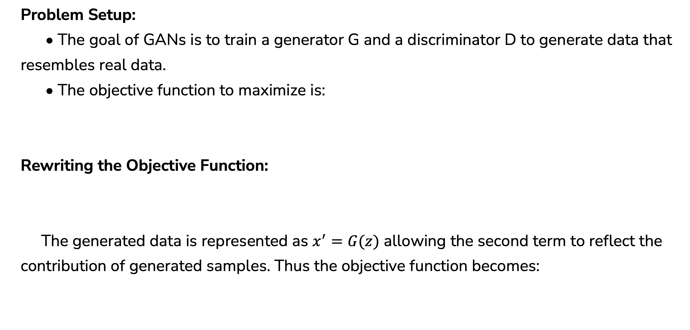
09
Training Process of GAN
Problem Setup:
• The goal of GANs is to train a generator G and a discriminator D to generate data that resembles real data.
• The objective function to maximize is:
Rewriting the Objective Function:
The generated data is represented as $x^{′}=G(z)$ allowing the second term to reflect the contribution of generated samples. Thus the objective function becomes:

Slide 15
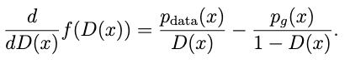
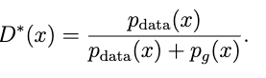
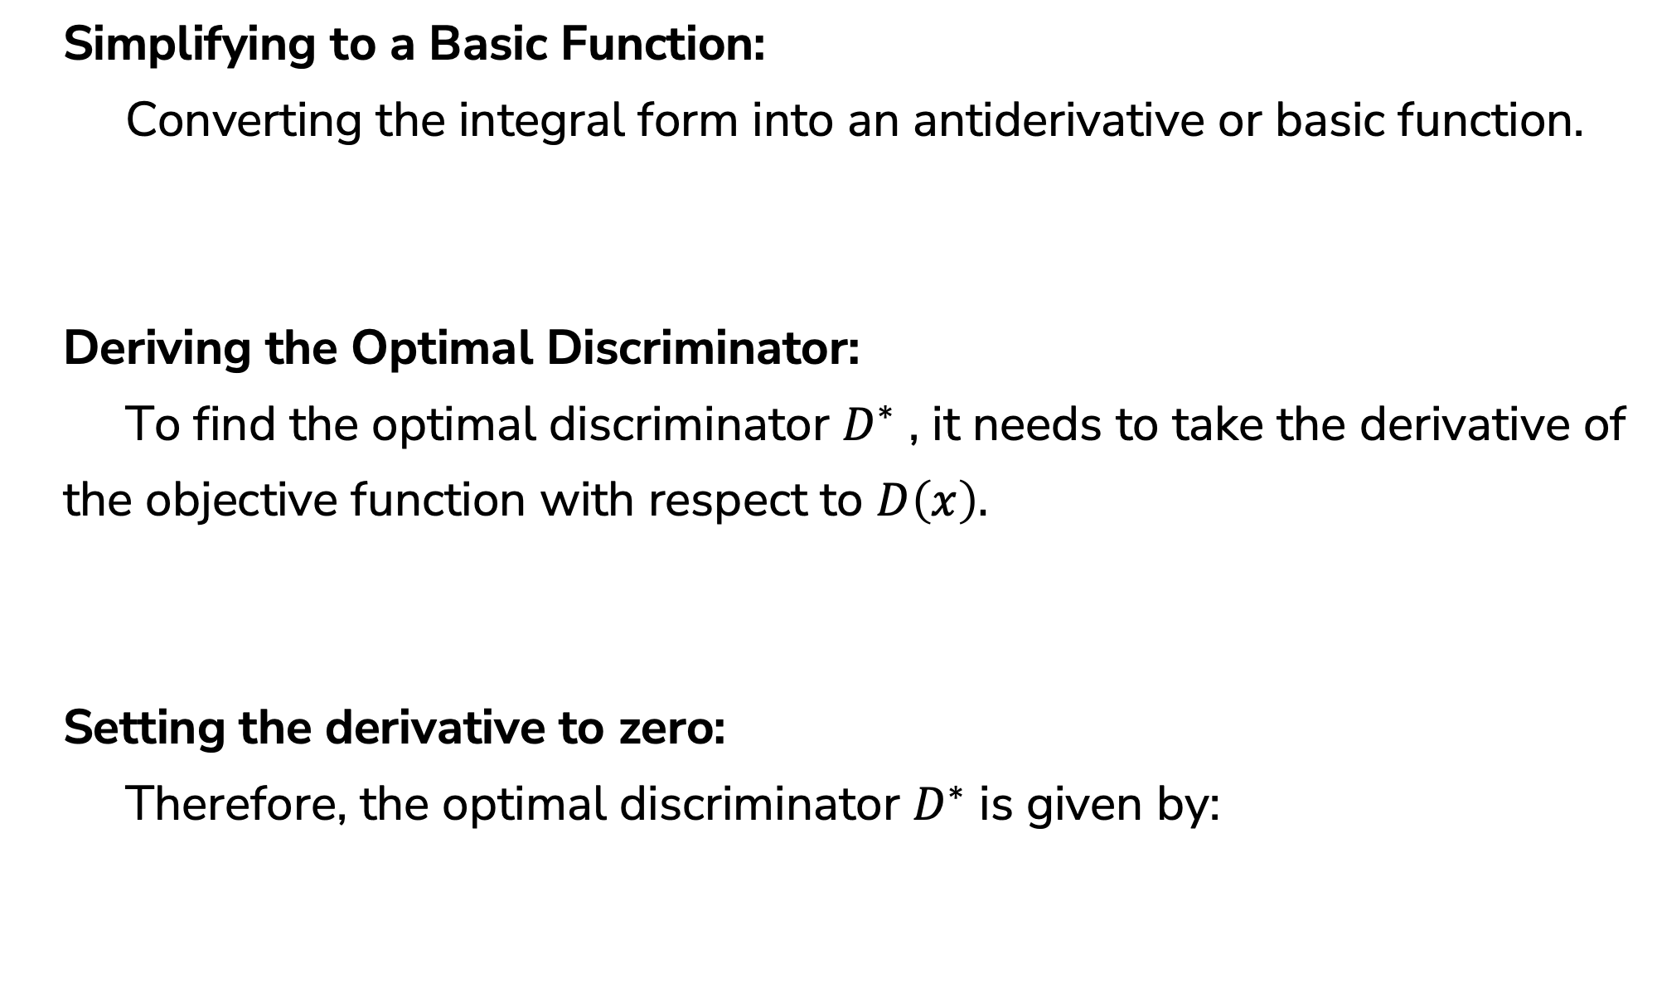
10
Training Process of GAN
Simplifying to a Basic Function:
Converting the integral form into an antiderivative or basic function.
Deriving the Optimal Discriminator:
To find the optimal discriminator $D^{∗}$ , it needs to take the derivative of
the objective function with respect to $D\left(x\right).$
Setting the derivative to zero:
Therefore, the optimal discriminator $D^{∗}$ is given by:

Slide 16
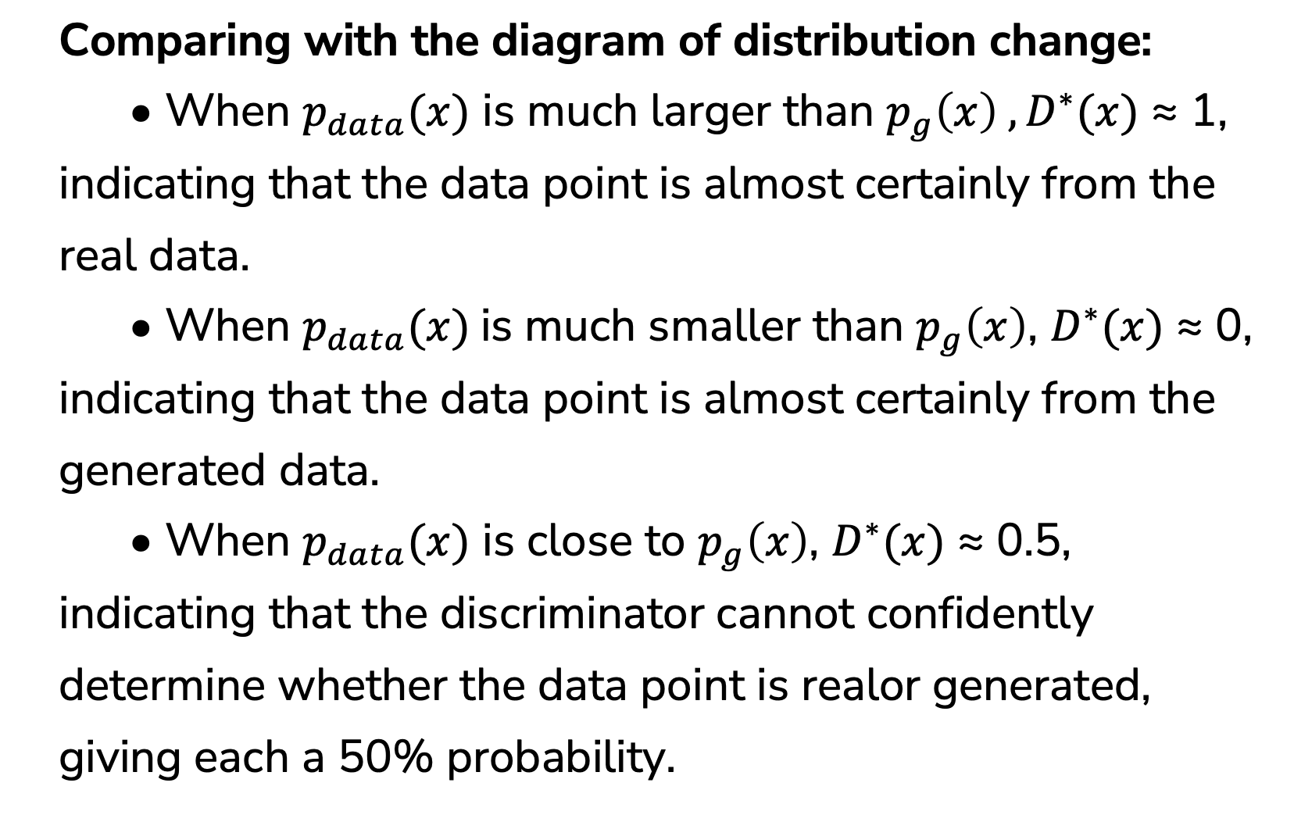
Verifying the Optimal Discriminator
11
Comparing with the diagram of distribution change:
• When $p_{data}(x)$ is much larger than $p_{g}\left(x\right) ,D^{∗}(x)$ ≈ 1, indicating that the data point is almost certainly from the real data.
• When $p_{data}(x)$is much smaller than $p_{g}\left(x\right)$, $D^{∗}(x)$ ≈ 0, indicating that the data point is almost certainly from the generated data.
• When $p_{data}(x)$ is close to $p_{g}\left(x\right)$, $D^{∗}(x)$ ≈ 0.5, indicating that the discriminator cannot confidently determine whether the data point is realor generated, giving each a 50% probability.

Slide 17
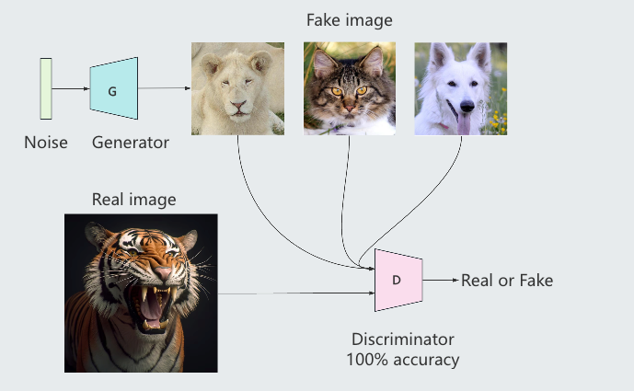
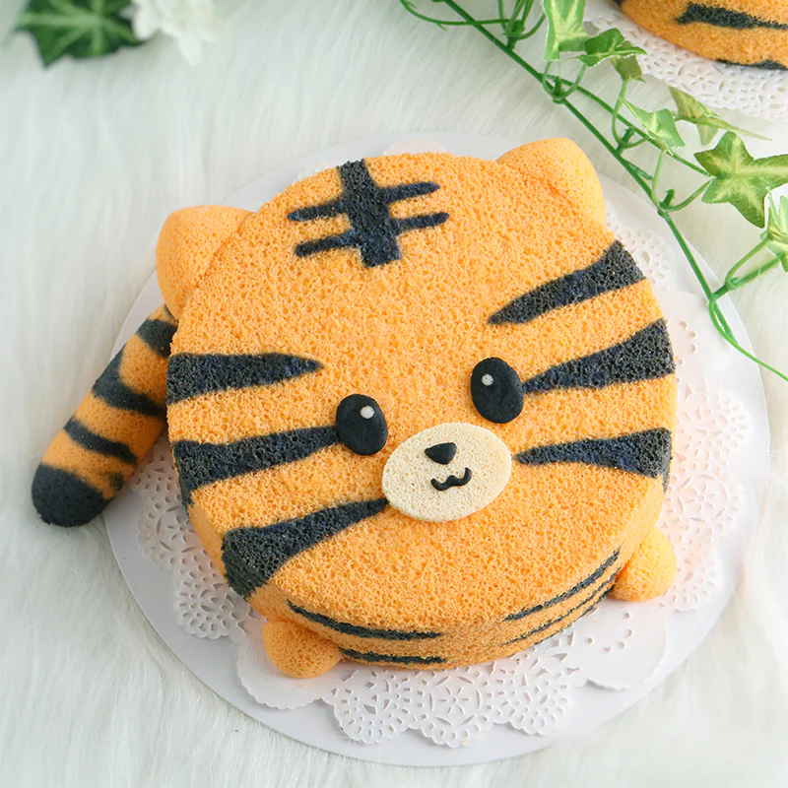
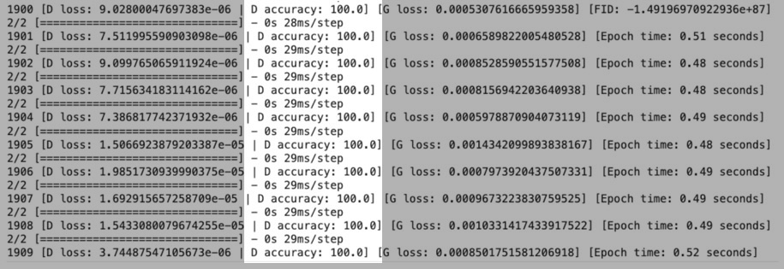
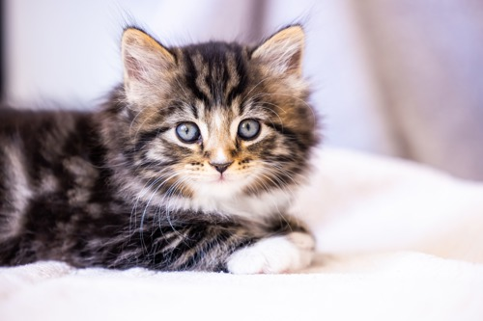
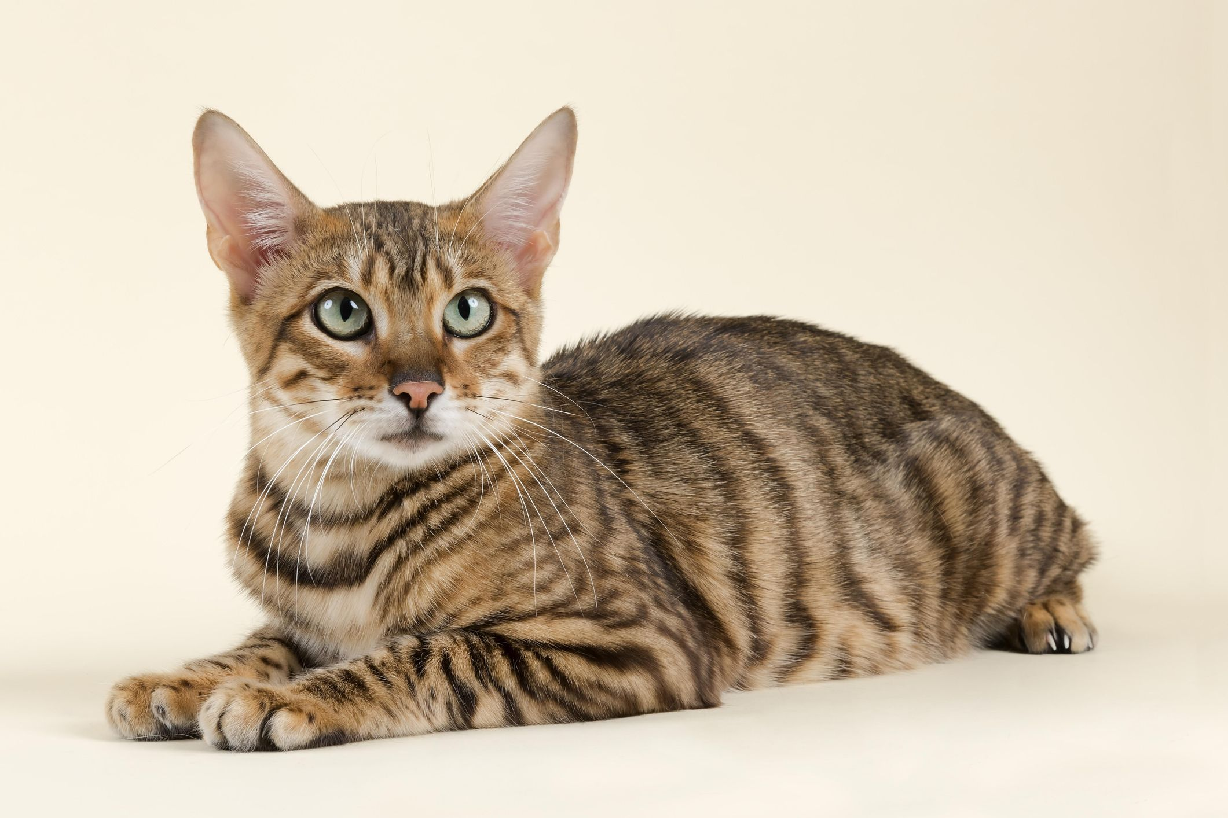
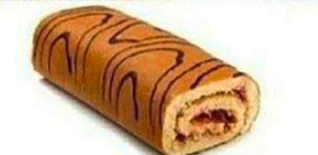
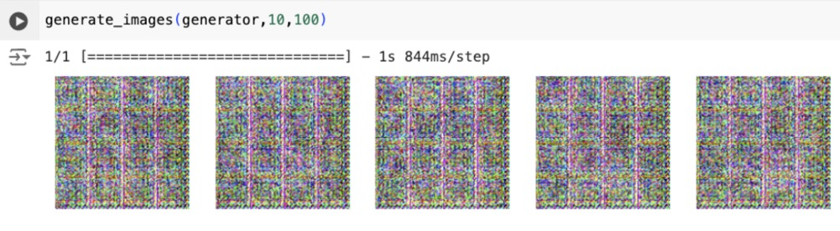
12
Evaluating GAN Performance
• In most machine learning models, accuracy is a key evaluation metric. However, in the case of GAN training, achieving 100% accuracy indicates a problem. It means that the balance between the generator and the discriminator is broken.

Slide 18
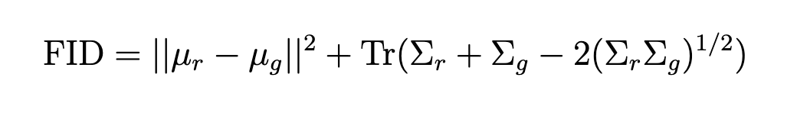
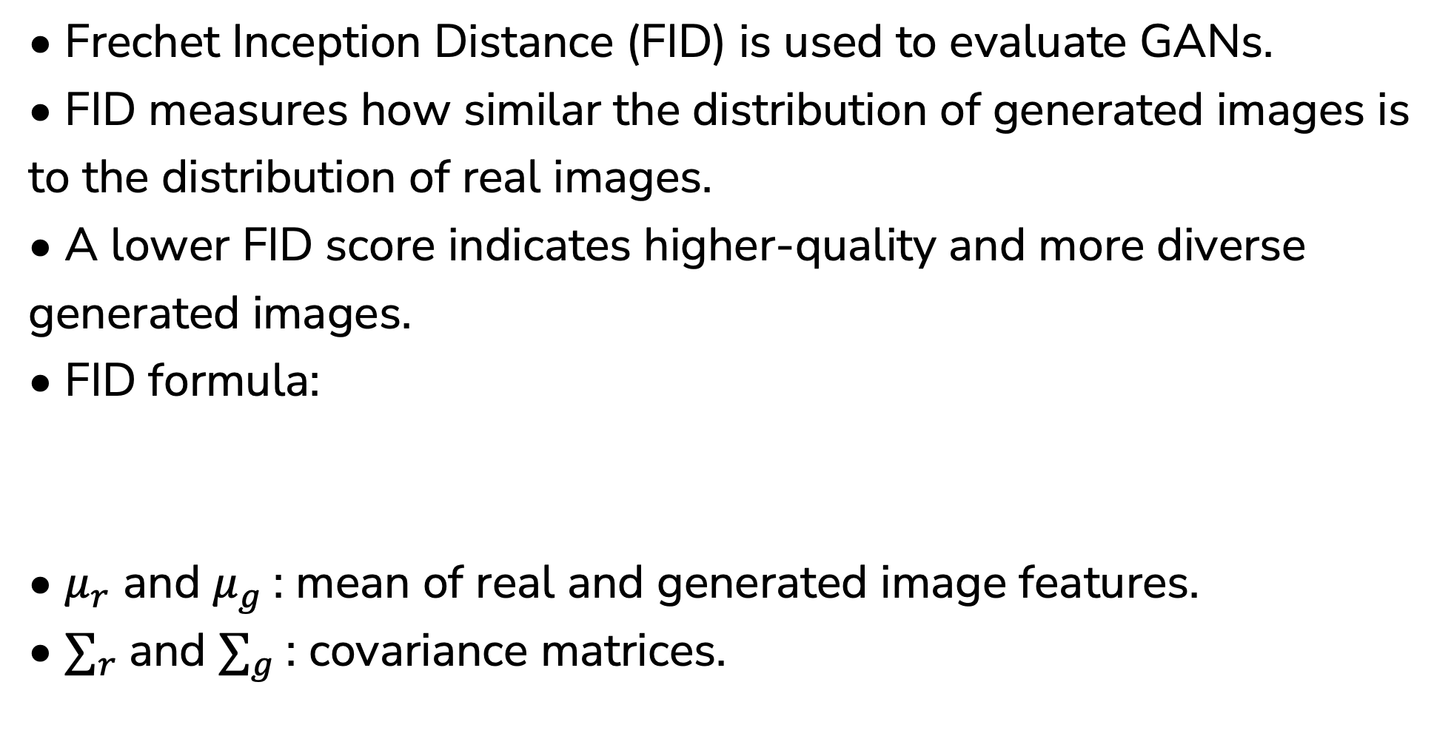
13
Frechet Inception Distance
• Frechet Inception Distance (FID) is used to evaluate GANs.
• FID measures how similar the distribution of generated images is to the distribution of real images.
• A lower FID score indicates higher-quality and more diverse generated images.
• FID formula:
• $μ_{r}$ and $μ_{g}$: mean of real and generated image features.
• $∑_{r}$and $∑_{g}$: covariance matrices.

Slide 19
University College Cork
4 Results

Slide 20
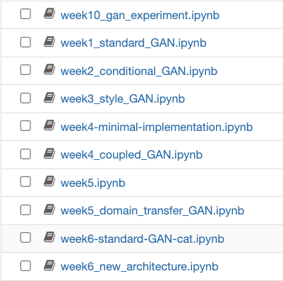
14
Model Select
Reason for Choosing Standard GAN:
• Foundational Model: Standard GAN serves as the base for all other GAN variants.
• Well-documented: Extensive literature available for comparison and reference.
• Training Efficiency: More computationally feasible to implement within hardware constraints.
• Flexibility: Can be adapted to various image generation tasks, providing a solid baseline for comparison with more complex models.

Slide 21
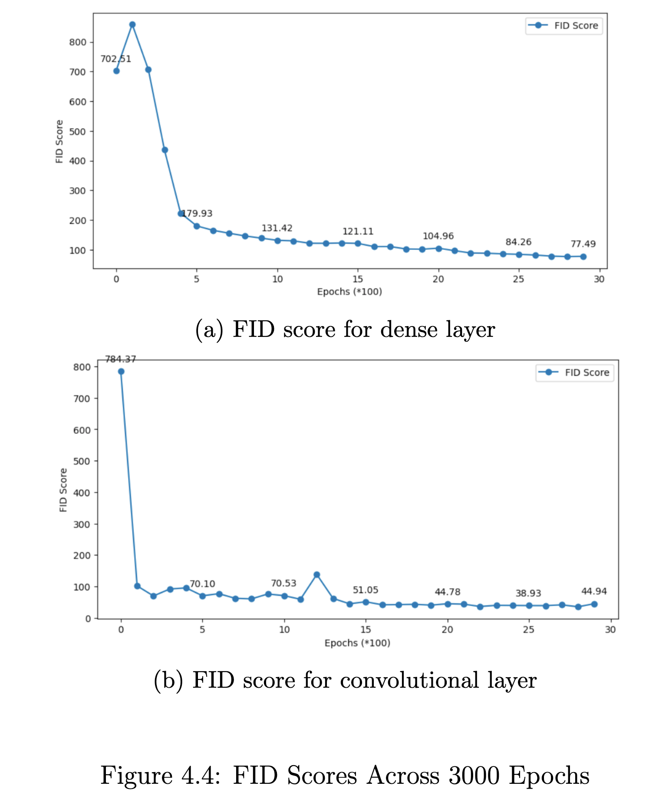
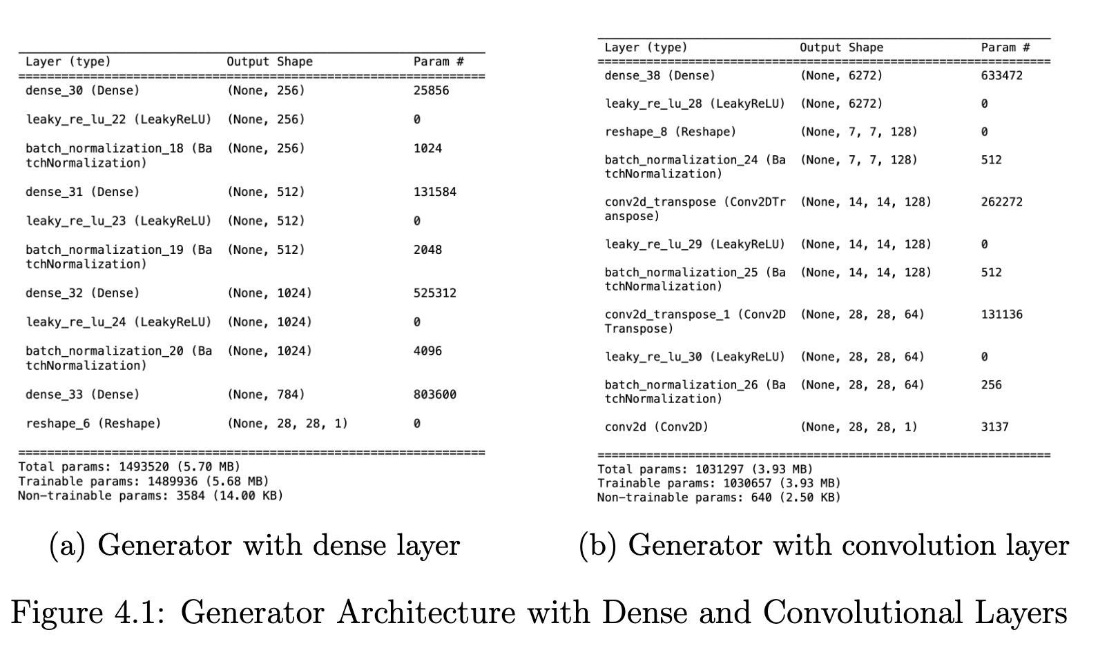
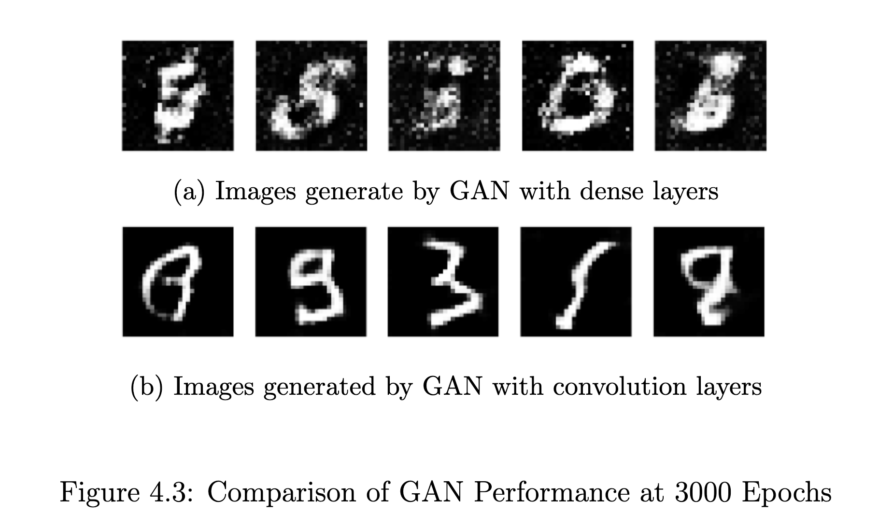
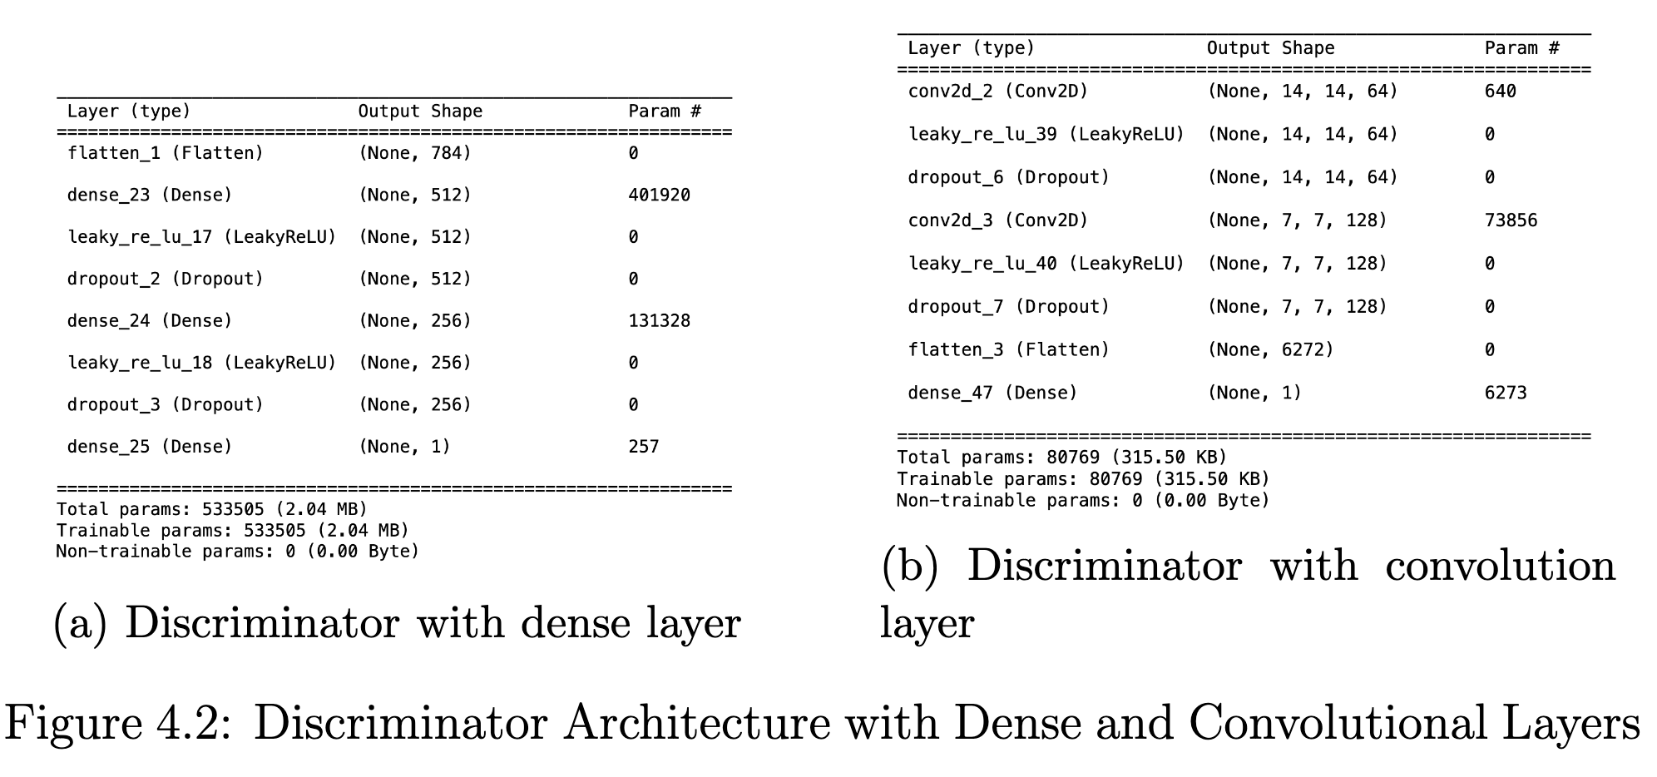
15
Convolutional or Dense
Objective:
• Compare the performance of Convolutional Layers and Dense Layers in the generator and discriminator of a standard GAN.
Key Factors Tested:
• Image quality.
• FID score.
• Training time.
Dataset:
• MNIST Dataset (3000 epochs).

Slide 22
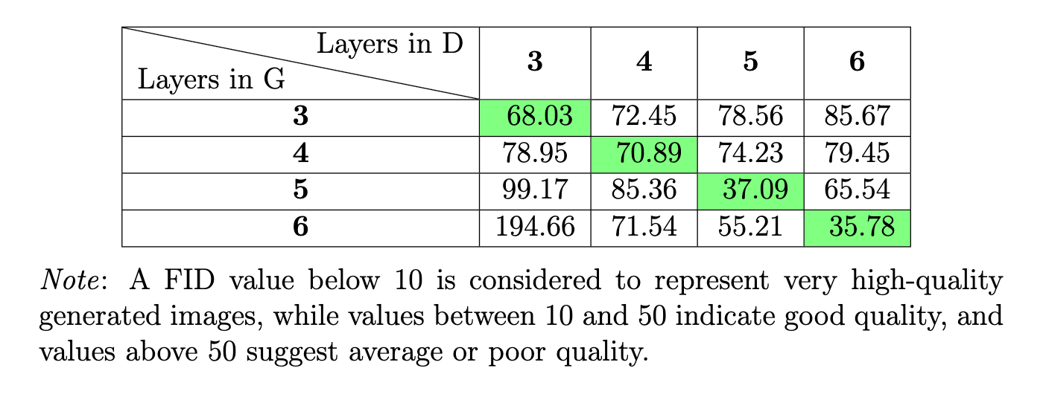
16
Exploring Layer Depth
Key Objective:
• Investigate the impact of increasing convolutional layer depth on GAN performance.
Experiment Setup:
• Base Model: Standard GAN (with convolutional layers).
• Layer Variations: 3, 4, 5, and 6 layers in both generator and discriminator.
• Key Metric: Frechet Inception Distance (FID) to evaluate image quality.
Results:
• Increasing depth in only the generator or discriminator leads to worse performance.
• Increasing depth in both networks simultaneously results in better performance.

Slide 23
17
Impact of Data Augmentation
Objective:
• Evaluate the impact of data augmentation techniques in GAN.
Techniques Tested:
• Rotation: Rotating images by a 10 degree.
• Shifting: Vertical and horizontal shift 0.1.
• Flipping: horizontal flips.
Results:
Without Data Augmentation model performs best.
After Adjustments:
• Removing certain techniques (e.g., flipping, rotation).

Slide 24
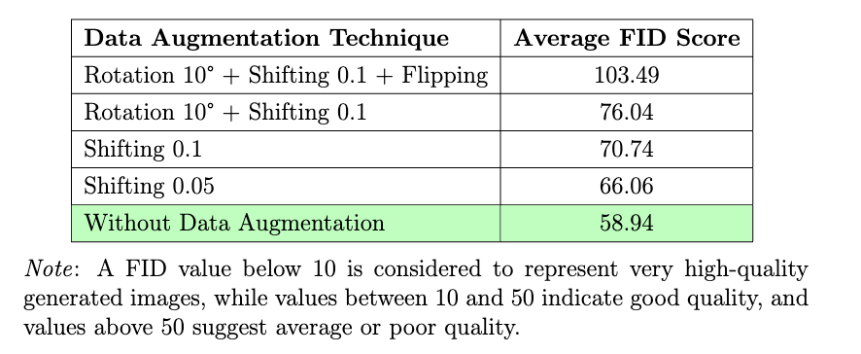
18
Impact of Data Augmentation
Results
Assumption:
Data augmentation introduced noise, disturbing the real data distribution.

Slide 25
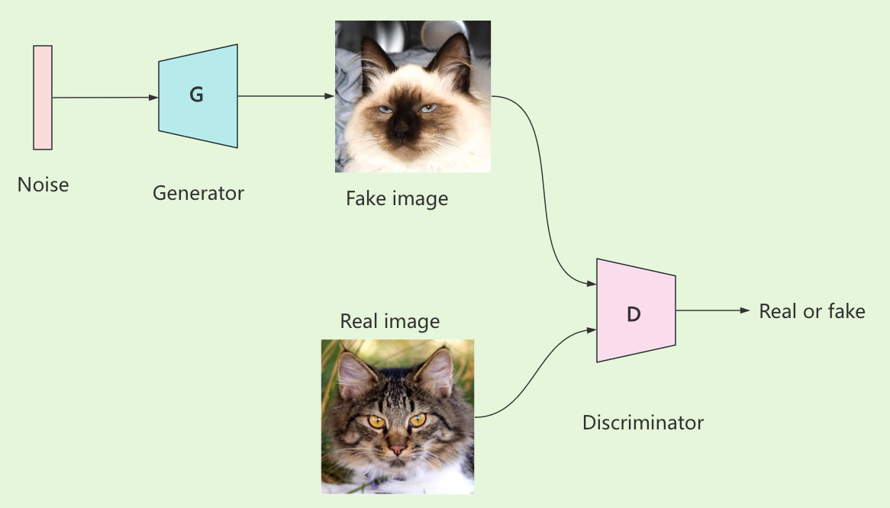
Applying Animal Faces HQ Dataset
19
Dataset Overview:
• Animal Faces-HQ (AFHQ) dataset contains 16,130 high-quality images of animal faces.
• Images are originally 512x512 pixels, downscaled to 128x128 pixels for memory efficiency during training.
Architecture:

Slide 26
Applying Animal Faces HQ Dataset
20
Model Structure:
• The generator takes a 100-dimensional noise vector, has 5 transpose convolutional layers with LeakyReLU activation and batch normalization, and outputs a 3×128×128 image.
• The discriminator takes a 3×128×128 image as input, has 5 convolutional layers with LeakyReLU activation, batch normalization, and dropout and outputs a single probability value indicating real or fake data.
Training Details:
• Optimizer: Adam.
• Learning rate: 0.0002.
• Epochs: 4000 epochs of training using this dataset.

Slide 27
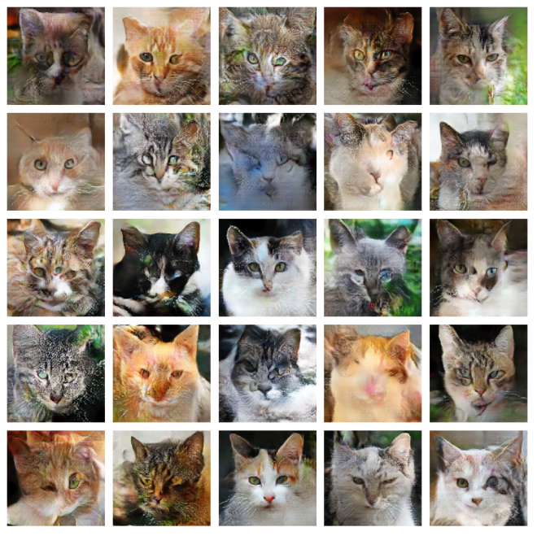
Generate Cat Faces
21

Slide 28
University College Cork
5 Discussion

Slide 29
Discussion
22
Model Performance:
• The generator demonstrated a capacity to produce relatively high-quality images.
• The discriminator showed effectiveness in distinguishing between real and generated data.
Challenges:
• Data Augmentation: Introduced noise, slightly affecting performance.
• Training Stability: Occasional instability due to adversarial training dynamics.
Evaluation:
FID Scores: Without data augmentation, the model performed more consistently.

Slide 30
Future Work
23
Model Improvements:
• Adjust hyperparameters for better stability.
• Explore advanced architectures like StyleGAN.
• Dataset:
• Use larger and more diverse datasets for improved generalization.
• New Techniques:
• Experiment with adaptive data augmentation methods.

Slide 31


University College Cork
Thank You

Slide 32
Future Work
23
$$\min_{G} \max_{D} V\left(D, G\right)=E_{x \sim p_{data}(x)}\left[\log{D\left(x\right)}\right]+E_{z \sim p_{z}(z)}\left[log (1 −{D\left(G(z)\right))}\right]$$
Model Improvements:
• Adjust hyperparameters for better stability.
• Explore advanced architectures like StyleGAN.
• Dataset:
• Use larger and more diverse datasets for improved generalization.
• New Techniques:
• Experiment with adaptive data augmentation methods.

